Slide 1
ARTIFICIAL INTELLIGENCE AND CYBER SECURITY IN CIVIL AVIATION
LARNACA, CYPRUS, 30 MAY 2024

Slide 2
Speaker Bio
Cpt Stelios Iacovou, MBA
Active Pilot since 1996
Commercial Pilot since 2002 (A320 / B777 / B787)
Other Roles: Pilot Trainer (CRMI / LTC / CARM / TRI)
Flight Operations Country Manager
IFALPA Director Cyprus since 2011

Slide 3
The International Federation of Air Line Pilots’ Associations – IFALPA
Founded in April 1948 by thirteen Member Associations to provide a formal means for pilots to interact with ICAO and other industry stakeholders
The GLOBAL VOICE of Pilots
International non-profit Organization
Represents 120,000 pilots in 70 countries
Mission: Promote the Highest Level of Aviation Safety worldwide
Global advocate of the piloting profession
Headquarters in Montreal, Canada

Slide 4
10 IFALPA Standing Committees
Accident Analysis & Prevention (AAP)
Aircraft Design and Operation (ADO)
Aerodrome & Ground Environment (AGE)
Air Traffic Services (ATS)
Dangerous Goods (DG)
Helicopter (HEL)
Human Performance (HYPER)
Legal (LEG)
Professional & Government Affairs (PGA)
Security (SEC)

Slide 5
Introduction
Civil Aviation today is a complex System of Systems
Flight crew are highly involved in this “System” and not just in the actual “act of flying the aircraft”. Instead, they are involved in many other processes surrounding Flight Operations
A High Degree of Automation already exists
Automation Dependency / Overreliance has been identified as potential safety issue – how do we deal with this is challenge?
The ICAO Personnel Training and Licensing Panel is, among other areas, dealing with this issue through its “Automation Dependency Subgroup” (IFALPA is involved)

Slide 6
Definitions (1)
What is Artificial Intelligence (A.I.)?
Artificial Intelligence (AI) is generally considered to be a discipline of computer science that is aimed at developing machines and systems that can carry out tasks considered to require human intelligence.
What is Machine Learning (M.L.)?
Machine learning (ML) is defined as a discipline of artificial intelligence (AI) that provides machines the ability to automatically learn from data and past experiences to identify patterns and make predictions with minimal human intervention.

Slide 7
Definitions (2)
What is Automation?
Automation is the independent accomplishment of a function by a device or system that was formerly carried out by a human.
What is Control Automation?
Control Automation is when an automated system executes actions or control tasks with some level of autonomy.
What is Information Automation?
Information automation includes information acquisition and integration. This type of automation would include filtering, distributing or transforming data, providing confidence estimates and integrity checks, and enabling user requests.
What is Autonomy?
Autonomy is increased aircraft automation (whether the aircraft is piloted or not), with various levels of situational decision-making made by the aircraft systems.

Slide 8
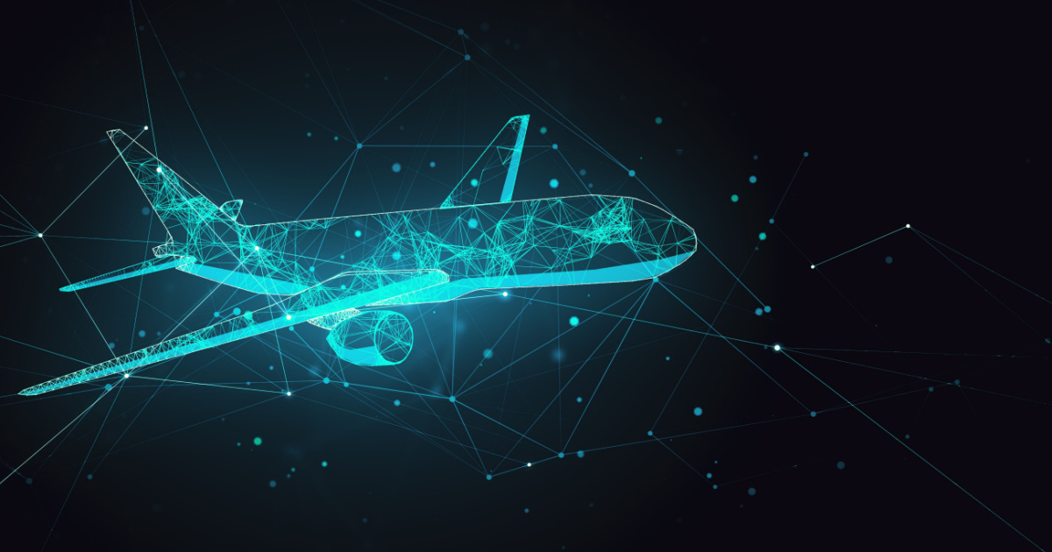
EASA Statement on How can Artificial Intelligence (AI) applications bring benefits to aviation?
Flight Operations example:
“Artificial intelligence may assist the crew by advising on routine tasks to enhance the operational efficiency of the flight. It can predict issues like turbulence and icing conditions and help the pilots in decision making when faced with a conflict.”

Slide 9
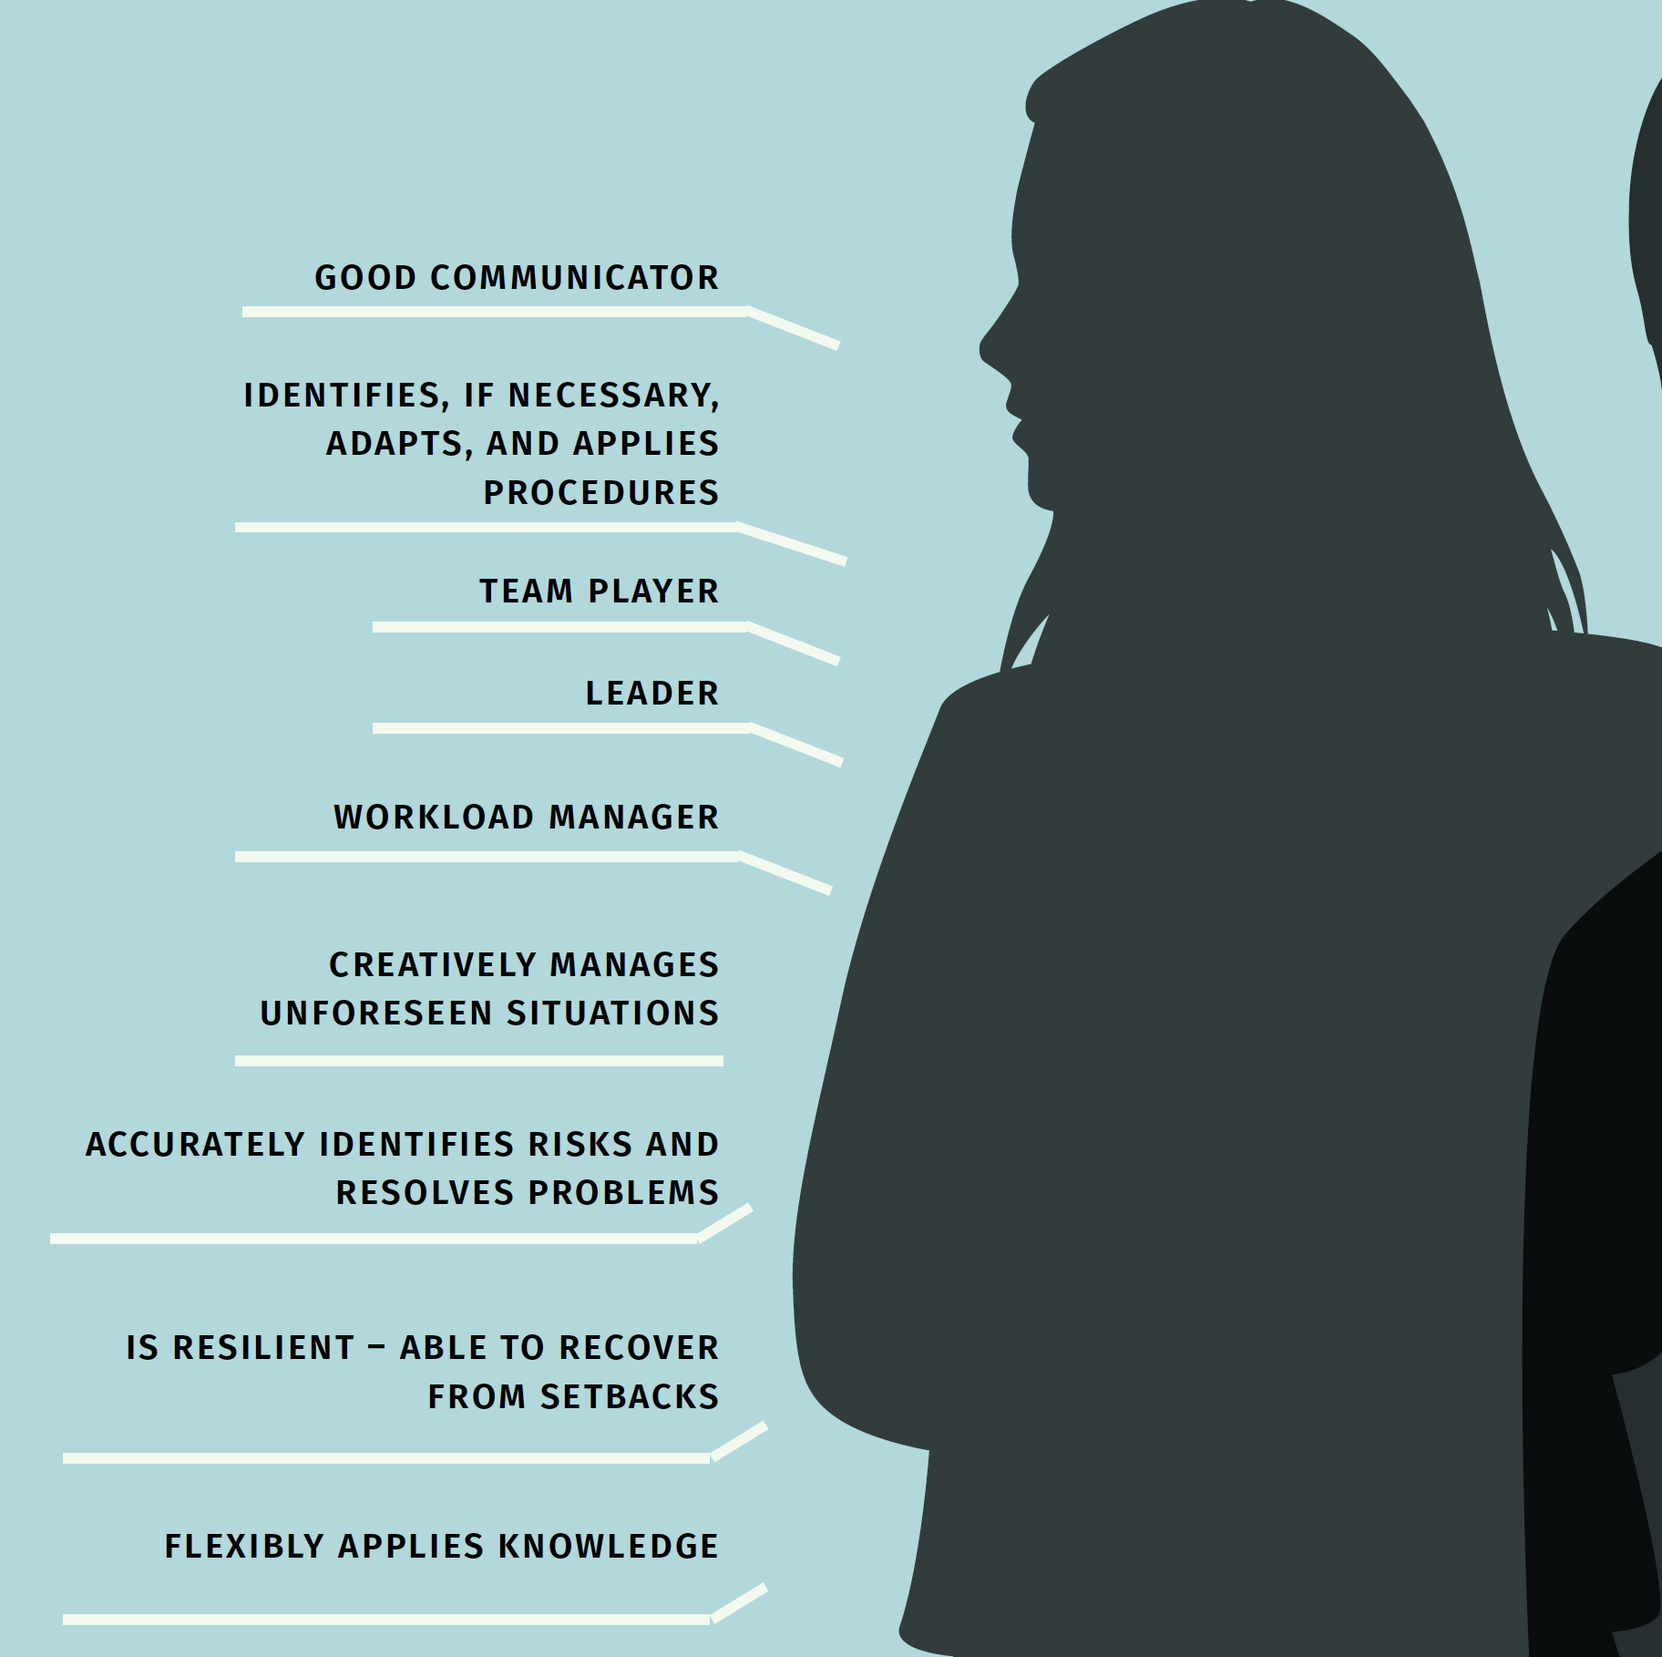
The Human and the concepts of Extended Minimum Crew Operations (eMCO) and Single Pilot Operations (SiPO)

Slide 10
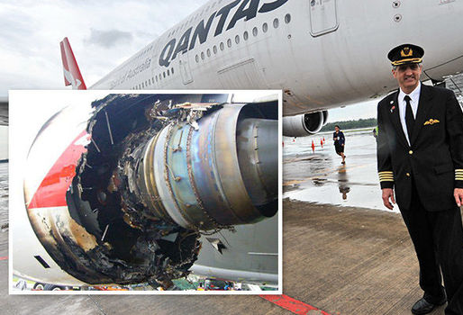
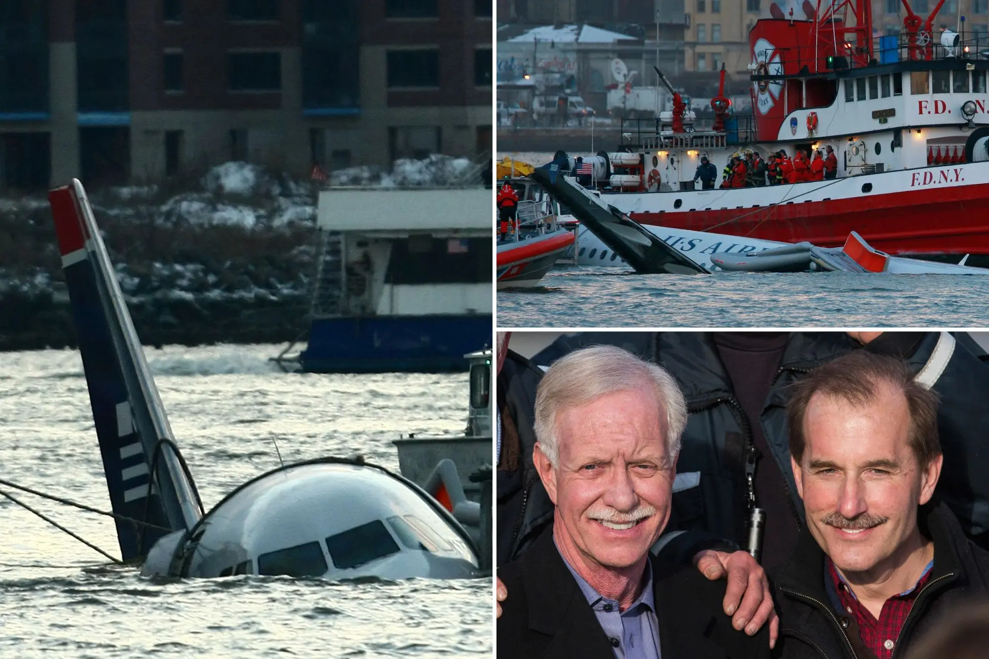
Augmenting and not replacing human capacity

Slide 11
Commercial pressure and transparency of the development and certification process

Slide 12
Flight Safety and Technical Aspects
Safety II Data
Creative Solutions
Pro-active Measurements
Incapacitation & Redundancy
Redundancy II
Cyber Security
Insider Threat(s) / SEC
Workload / Role of two Pilots
Crew Resource Management (CRM)
Pilot at Ground Station
Procedures
Training
Physiological Limitations and Workload
Fatigue
”Wake-up time”
Competency path for Command
Interaction with Air Traffic Management, Technology and UAS Development

Slide 13
Security

Slide 14
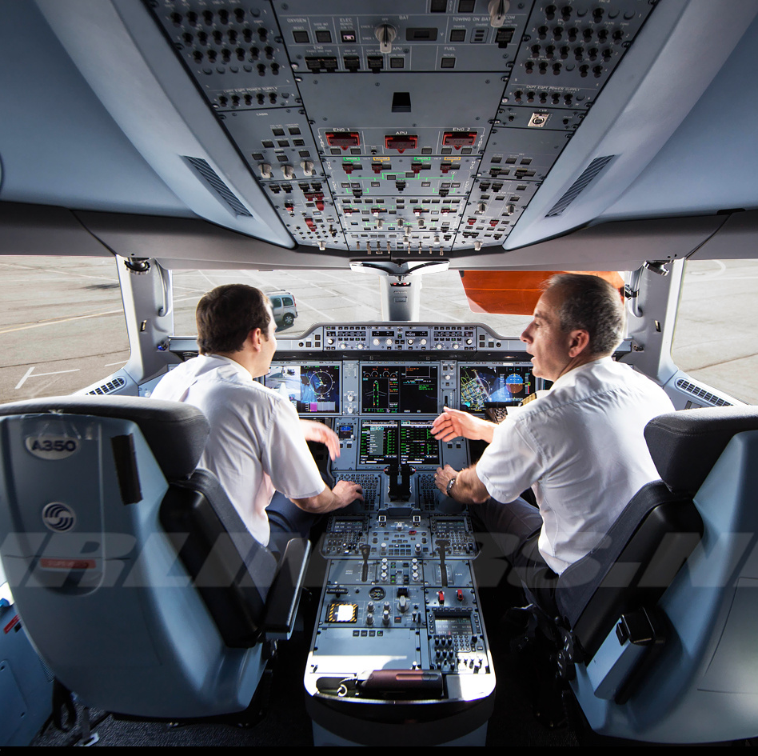
Conclusions
AI/ML NOT a substitute for pilots
“One means none”
AI/ML ultimately still a “tool”
Better use of Resources:
Airspace Infrastructure
Sustainable forms of Propulsion
Enhanced Safety
Reduced Environmental footprint

